Slide 1
SDLC & Software environments organization

Slide 2
SDLC Definition
The software development life cycle (SDLC), also referred to as the application development life-cycle is a term to describe a process for planning, creating, testing, and deploying an information system.
-Wikipedia

Slide 3
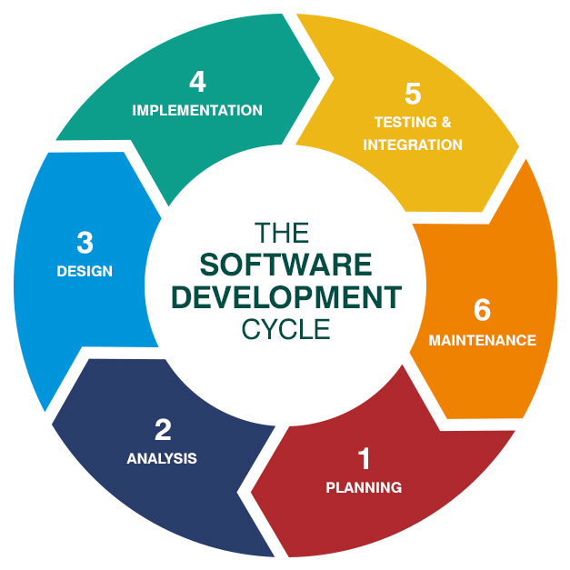
SDLS Phases

Slide 4

PLANNING
The most critical phase as you decide what exactly you want to do and what problems to solve by:
identifying problems, goals and resources (such as staff and costs)
exploring alternative solutions through meetings with customers, suppliers, consultants and staff
finding the ways to make your product better than the one your competitors have.
After analyzing this data, you will have three options: to develop a new system, improve the existing one or leave the system as it is.

Slide 5

ANALYSIS
At this stage it is necessary to define and document the requirements of the end user of the system (the expectations and how to implement them). Communication with customers is very important as you should have a clear vision of the end product and its functions. Moreover, the project should be organizationally, economically, socially and technologically executable.

Slide 6
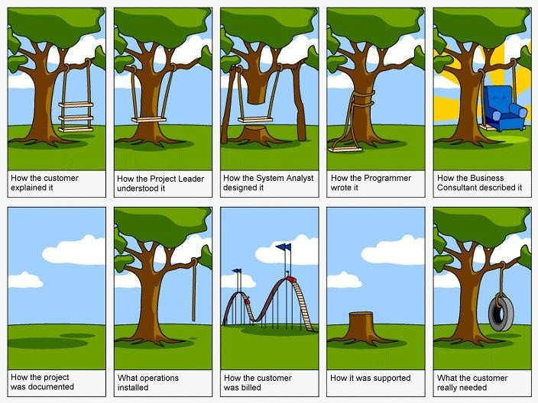

Slide 7

DESIGN
This phase defines the system elements, components, security level, modules, architecture, various interfaces and data types that the system operates on.

Slide 8

IMPLEMENTATION
This is actually the process of system development, when the design of the system is already fully completed and clear. In the life cycle of system development, it is here that the code is written, and if the system includes a hardware part, the implementation phase will include the configuration (both software and hardware) for certain requirements and functions of the end user. At this point the system is ready for usage.

Slide 9

TESTING & INTEGRATION
Here various components and subsystems are assembled into one complete system. Then we give the system various incoming data and analyze the output, behavior and functioning. Testing can be performed either by real users or by separate team to ensure that the actual product corresponds to the requested one.

Slide 10
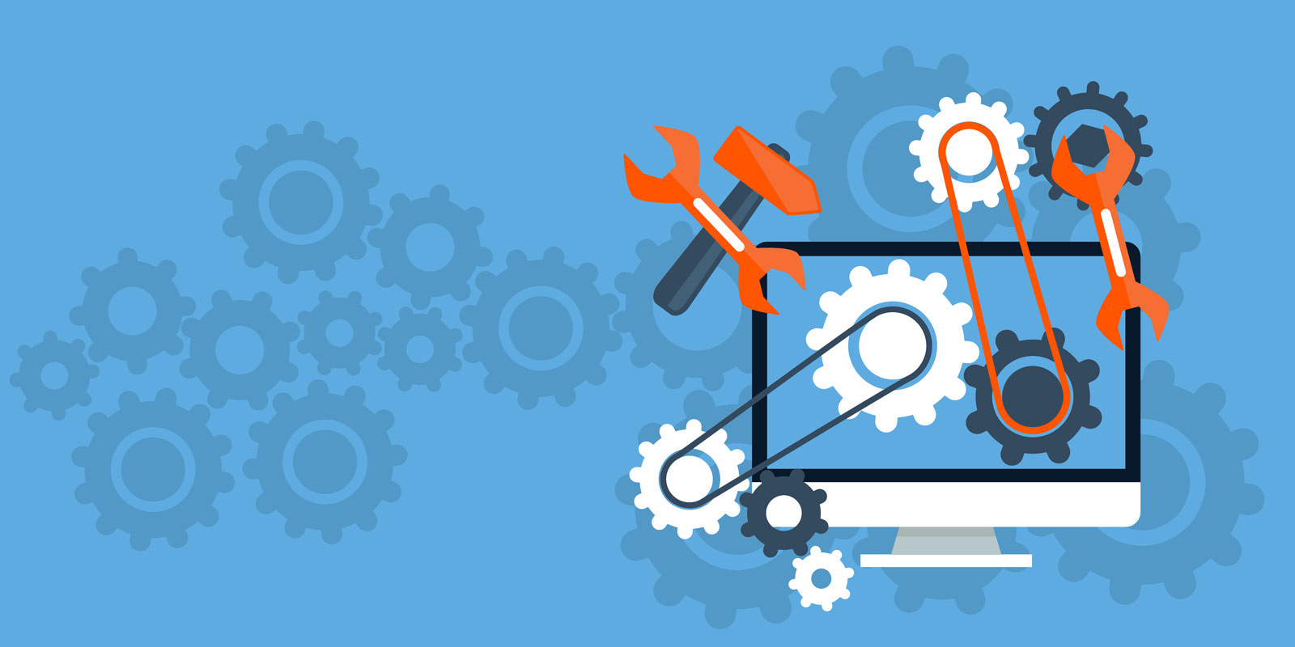
MAINTENANCE
At this phase the periodical technical support of the system takes place to ensure that the system is up to date. It includes equipment replacement, system components and security updates.

Slide 11
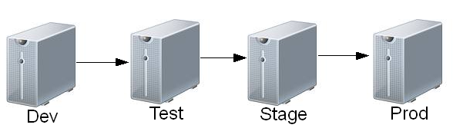
Software environments organization
Dev | Development server. This is where unit testing is performed by the developer.
Test / QA | This is the stage where interface testing is performed. Quality assurance team make sure that the new code will not have any impact on the existing functionality and they test major functionalities of the system once after deploying the new code in their respective environment(i.e. QA environment)
Stage / Pre-production | Mirror of production environment
Production / Live | Serves end-users/clients

